Slide 1
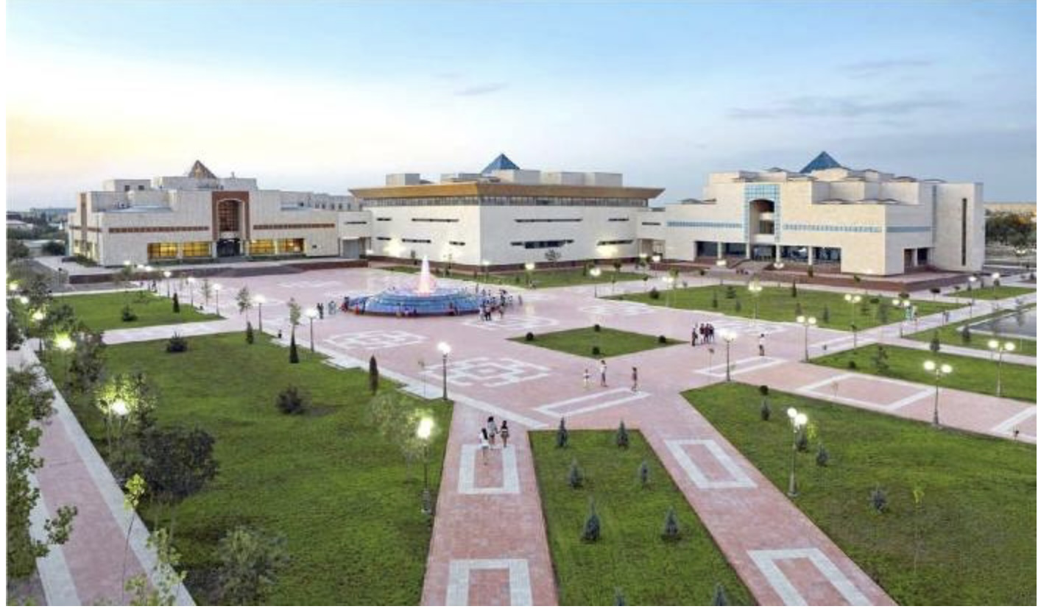
Karakalpak as low-resource language in NLP.

Slide 2
Hypothesis and Questions
1. Karakalpak is a turkic language.
2.Why have you never heard of it or have very limited knowledge about that?
3. How wide its usage today?
3.What are unique features of this language?
4. Is there any possible difficulties to create UD annotions in Karakalapak?

Slide 3
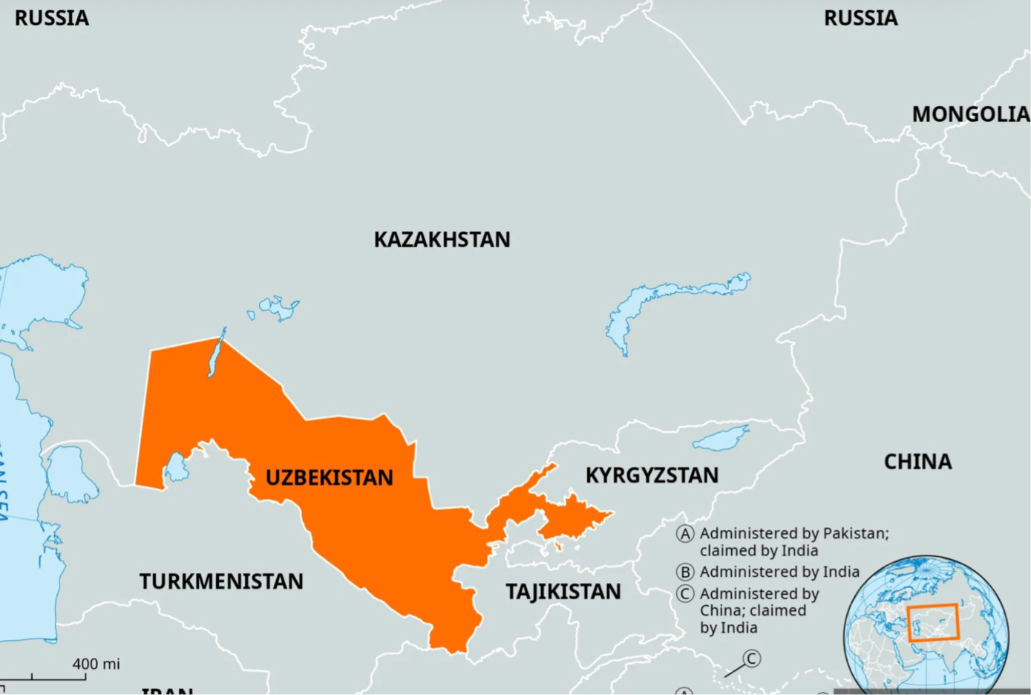

Slide 4
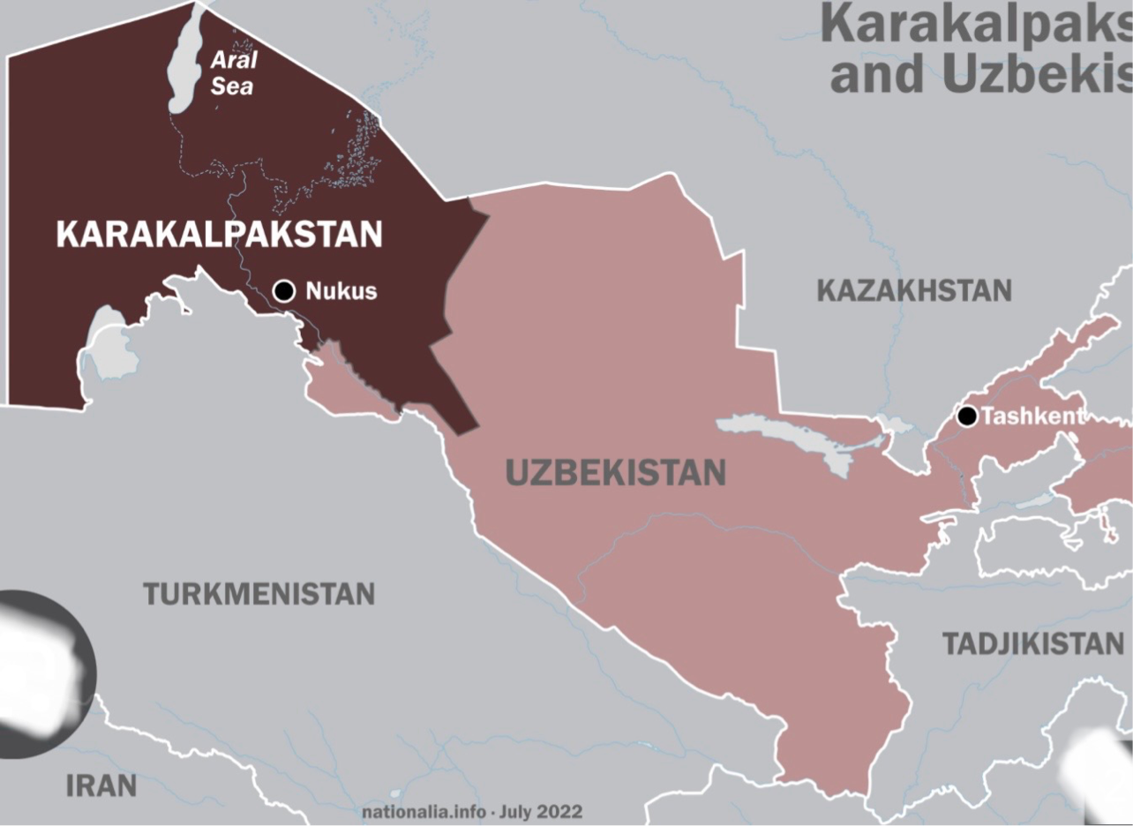

Slide 5
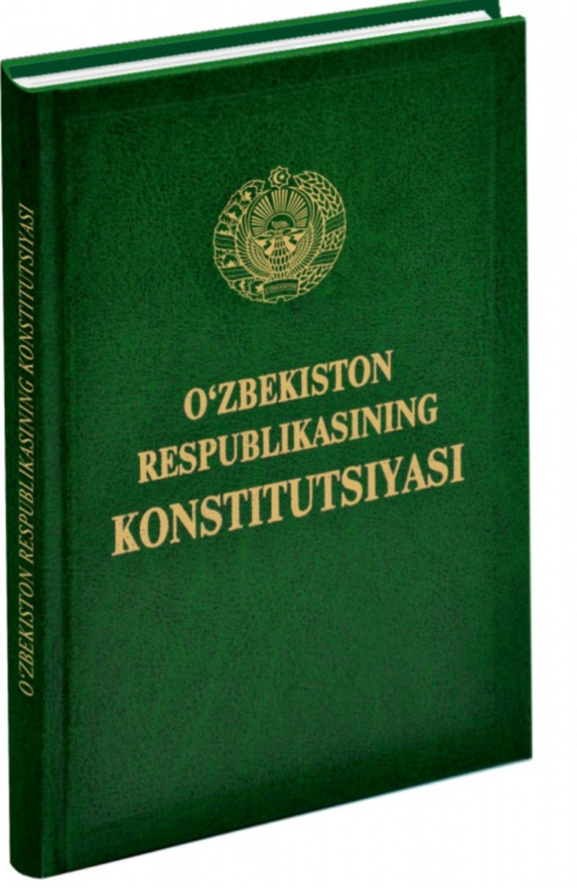

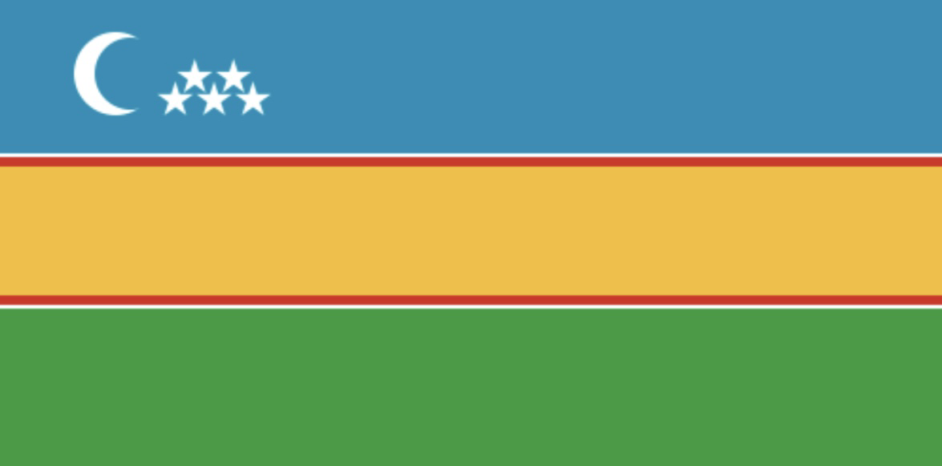

Slide 6
Turkic Language Family
Oghuz (Southwestern Turkic)
Kipchak (Northwestern / Northern Turkic)
Karluk (Southeastern Turkic)
Siberian / Northeastern Turkic
Chuvash (Oghur / Lir Turkic)

Slide 7
KIPCHAK
Kipchak–Nogai
Karakalpak
Kazakh
Noghay
...
Kipchak–Kyrgyz
Kipchak–Bulgar

Slide 8
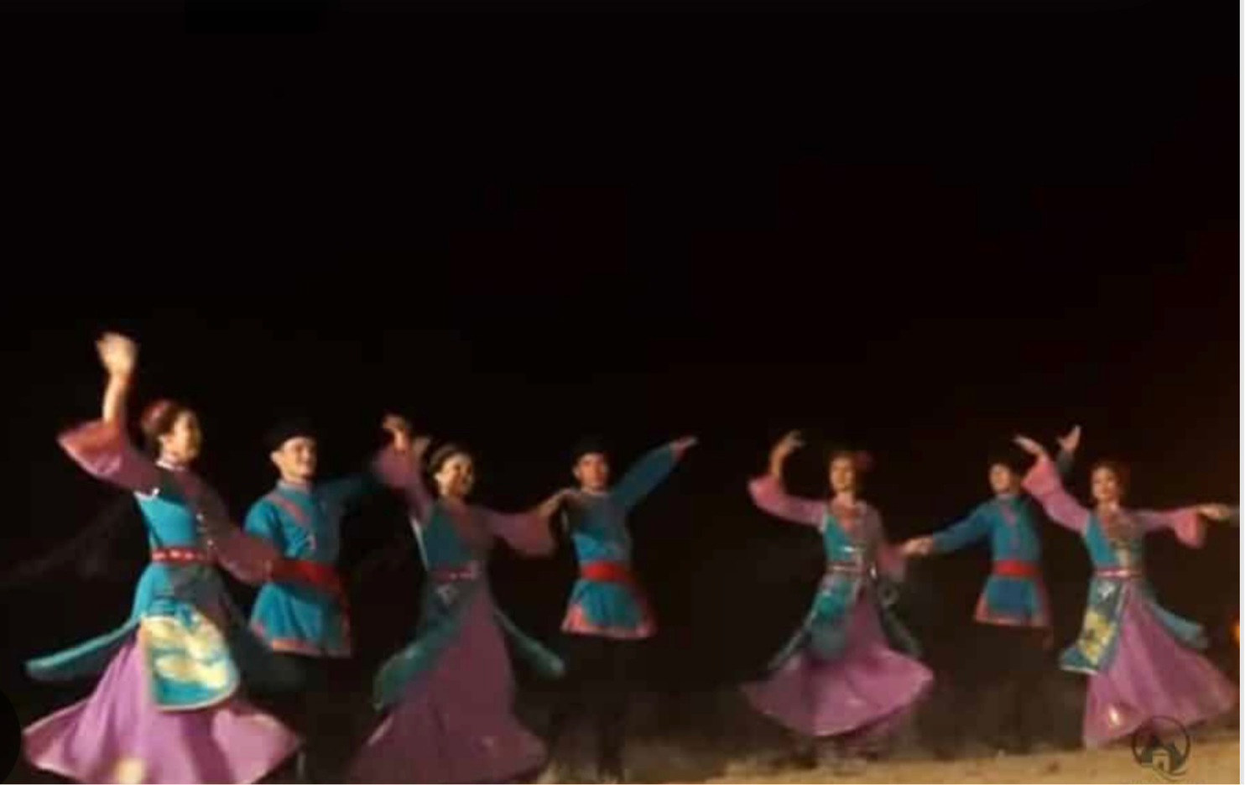
Karakalpak as a live language
Karakalpak is used as the language of instruction in schools and media ,families in the region(www.ethnologue.com)
Erkin Qaraqalpaqstan is the main Karakalpak-language newspaper. circulation ~2,700 in 2007, it’s still in print.
Qaraqalpaqstan TV channel, launched in 1964, airs ~18 hours daily in Karakalpak (plus Uzbek, Kazakh, Russian). Around 88% of the population watches it(en.wikipedia.org)

Slide 9
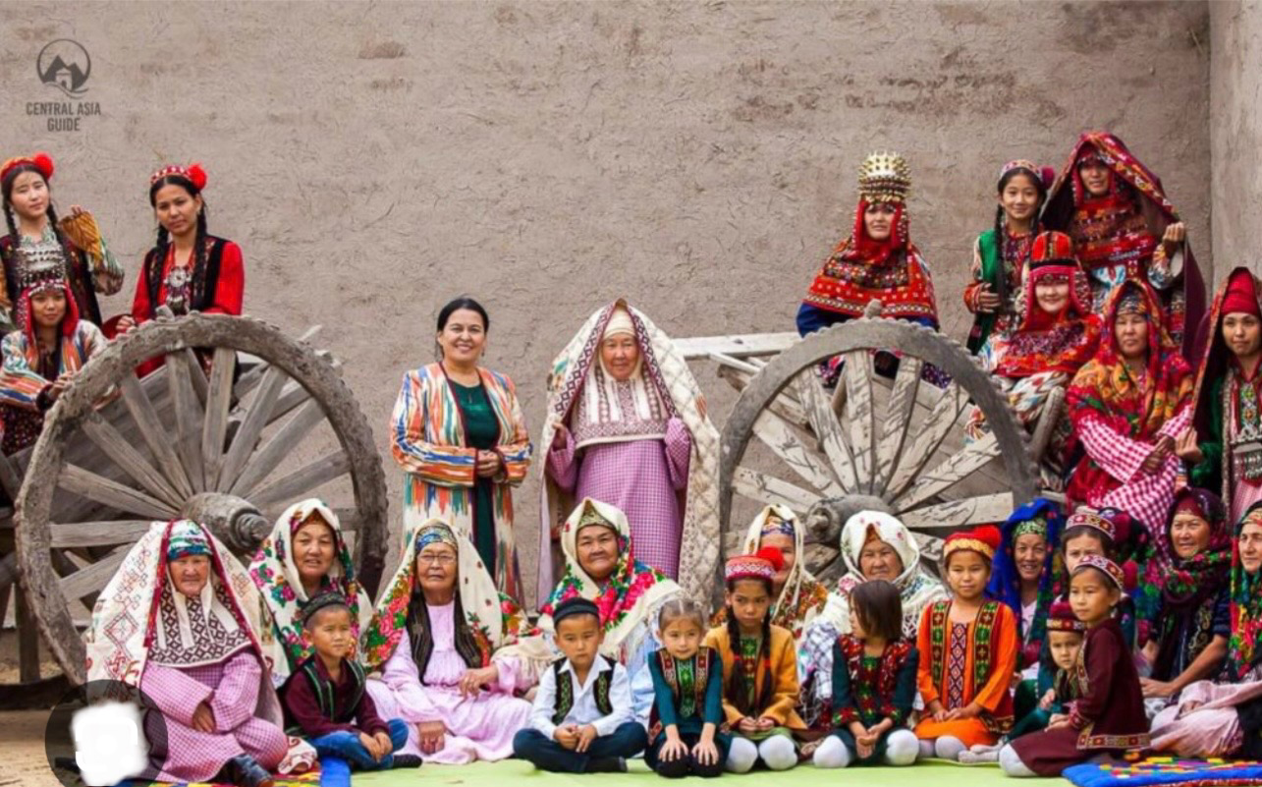
Karakalpak as a live language
The independent news site Makan.uz (run by Karakalpak journalist Lola Kallikhanova) had a Telegram channel with ~65,000 subscribers as of 2020,Telegram Pa’ziylet.uz/“Рәсмий канал” (official channel), is huge, with between 74K subscribers.
However, political-focused Telegram channels can be sensitive—some discussing Karakalpakstan or autonomist issues have faced blockages, cyber attacks, or even surveillance

Slide 10
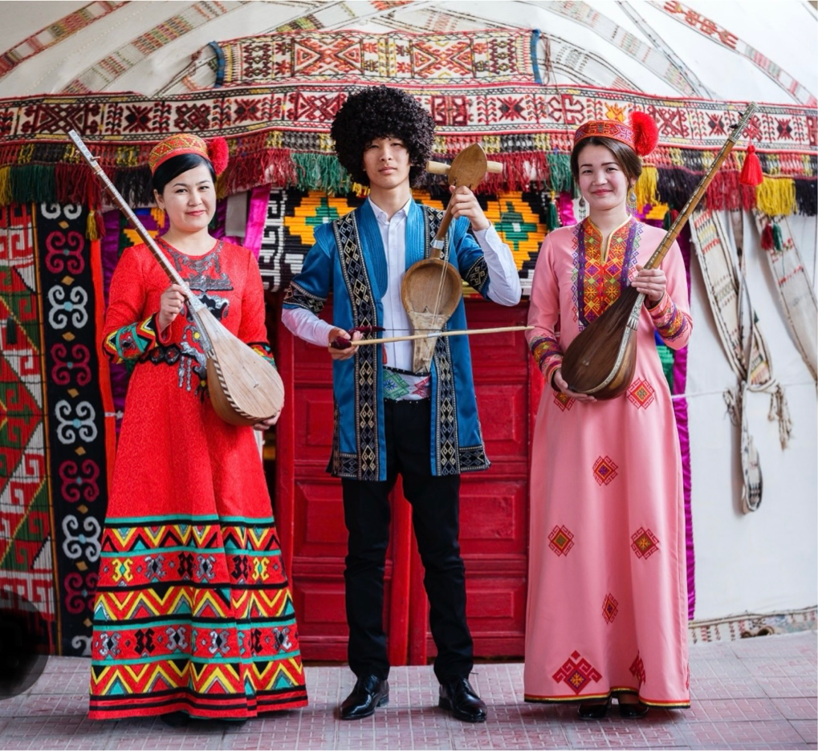
Why low-resource?
Number of Speakers (2023 est.)
Karakalpak → ~872,000 speakers
Kazakh → ~13–14 million speakers
Uzbek → ~32–35 million speakers
Turkish → ~85–90 million native speakers (and 5–10M more second-language)
Karakalpak Publications & Transmission
For centuries, Karakalpak folklore (like Qırq Qız, Alpamıs, proverbs, riddles) was passed from generation to generation orally - beautiful, but in tech terms it counts as low-resource.
Nowadays, some books are being scanned and shared as PDFs.But that’s still “flat text” → not editable, not machine-readable.No big corpora, no DOC/TXT structured data yet.
Limited funding & research
Big languages (English, Turkish, Uzbek, Kazakh) get heavy government + academic support.

Slide 11
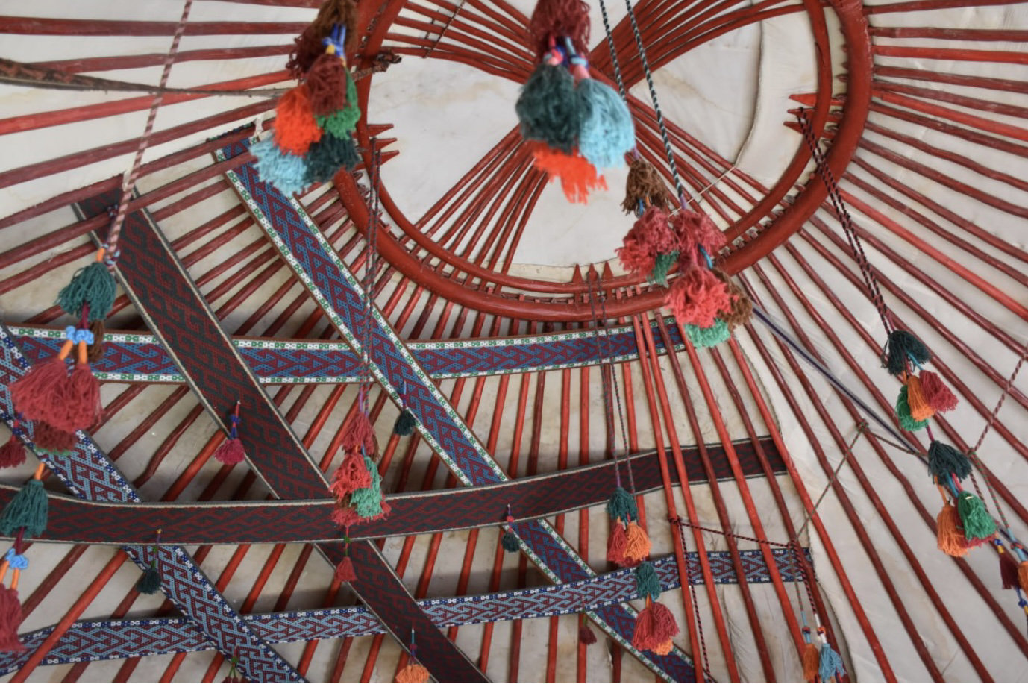
We are students.
☑︎Bizler studentlermiz(Karakalpak,Kipchak–Nogai)
Біз студенттерміз (Kazakh,Kipchak–Nogai)
Биз студенттербиз(Kyrgyz,Kipchak–Kyrgyz)
Biz talebelermiz (Crimean Tatar latin, Kipchak–Bulgar)
Беҙ студенттар (Bashkir, Kipchak–Bulgar)
Biz öğrenciyiz (Turkish)

Slide 12
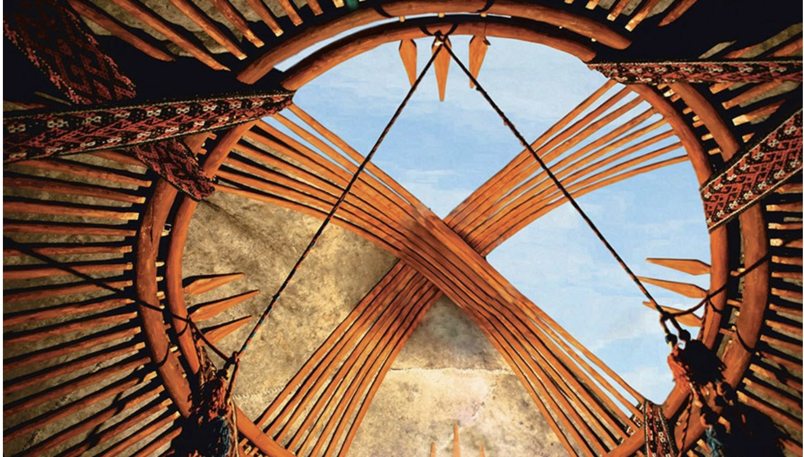
There is no UD treebank for Karakalpak yet.
would propose a new treebank .
ud_karakalpak .
contribution to both linguistic diversity and coverage to UD.
Challenges :
Low-resource status&Digital absence
Standardisation issues
Borrowings
Morphological complexity

Slide 13
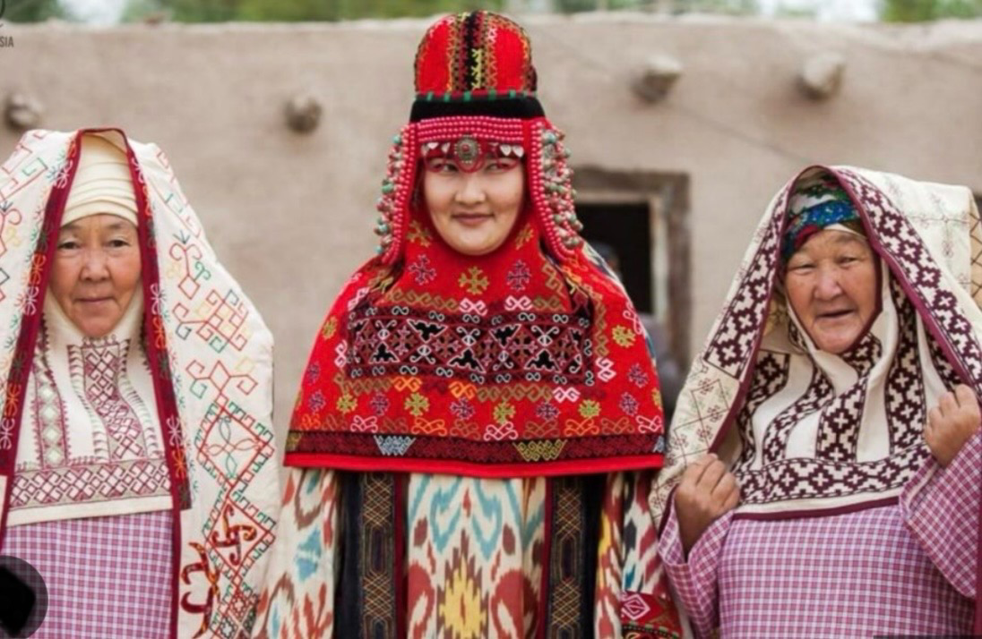
Standardisation issues.
Karakalpak was written in the Arabic and Persian script until 1928,
in the Latin script (with additional characters) from 1928 to 1940, after which Cyrillic was introduced.
Following Uzbekistan's independence in 1991, the decision was made to drop Cyrillic and revert to the Latin alphabet (1994).

Slide 14
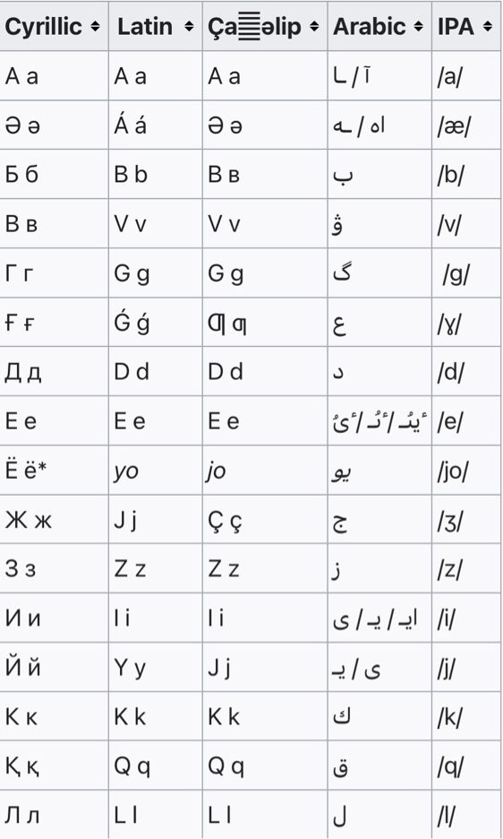
Standardisation issues.
dontbeidle/kaalin-python, author: Turdıbek Jumabaev (@erinshek) Latin ↔ Cyrillic transliteration ( GitHub)
latin2cyrillic,
cyrillic2latin
ь/ъ—´ ´
э/е — ´e´

Slide 15
Standardisation issues.
Karakalpak first keyboard. Shaǵala Lab author Atabek Murtazaev
https://github.com/shagalalab/qqkeyboard-android
Hugging Face: A parallel corpus with 300,000 sentence pairs, divided equally into:
Karakalpak–Uzbek (100,000)
Karakalpak–Russian (100,000)
Karakalpak–English (100,000)
o’—o/ò, orta, òpepek
i—i/ì, iyne,ìlaq
u’—u/ù, uwayim,ùy
n’—n/ń nan,toqtań

Slide 16
Borrowings .
Code-switching:
Uzbek, Kazak and Russian influence.
Kitaplarimdi tapsiraman , sosin domoi.—u‘yge…
( I will return my books, then home)
Hayojanlanip turman.—tolqinlanip…
( i am nervous)
kelesinba? — seń..
(Will you come?)

Slide 17
Morphological complexity.

Slide 18
Qaraqalpaqlastirilg’anlardanbiz.
“we are from those who were made into Karakalpaks”
(literally: “from the ones that have been Karakalpak-ified, we.”)
[Qaraqalpaq]NOUN → [Qaraqalpaq-la-stir]VERB
→ [Qaraqalpaq-la-stir-il]VERB → [Qaraqalpaq-la-stir-il-g’an]ADJ
→ [Qaraqalpaq-la-stir-il-g’an-lar]NOUN→ [Qaraqalpaq-la-stir-il-g’an-lar-dan]NOUN→ [Qaraqalpaq-la-stir-il-g’an-lar-dan +biz (we)]NOUN.

Slide 19
Qaraqalpaqlastirilg’anlardanbiz.
Karakalpak (independent pronoun as subject)
root
└─1 Qaraqalpaqlastirilg’anlardan (NOUN, Case=Abl, Number=Plur)
└─2 biz (PRON, Person=1, Number=Plur) [nsubj]
└─3 . (PUNCT) [punct]
Biz keshiktik- we are late.

Slide 20
Türkleştirilenlerdeniz
Turkish (copula suffix split as AUX)
root
└─1 Türkleştirilenlerden (NOUN, Case=Abl, Number=Plur)
└─2 iz (AUX, Person=1, Number=Plur, Tense=Pres) [cop]
└─3 . (PUNCT) [punct]

Slide 21
Other important points
Turkish UD (larger, more standardised treebank), use the AUX + cop
# text = Ol aqıllı edi
# gloss = he smart COP.PAST
1 Ol ol PRON _ Case=Nom|Number=Sing|Person=3|PronType=Prs 2 nsubj _ He
2 aqıllı aqıllı ADJ _ Degree=Pos 0 root _ smart
3 edi e- AUX _ Aspect=Perf|Mood=Ind|Tense=Past|VerbForm=Fin 2 cop _ was
Kazakh UD (closer genetically/typologically), use the VERB root + xcomp
# text = Ol aqıllı edi
# gloss = he smart COP.PAST
1 Ol ol PRON _ Case=Nom|Number=Sing|Person=3|PronType=Prs 3 nsubj _ He
2 aqıllı aqıllı ADJ _ Degree=Pos 3 xcomp _ smart
3 edi e- VERB _ Aspect=Perf|Mood=Ind|Tense=Past|VerbForm=Fin 0 root _ was

Slide 22
Questions , ideas ,suggestions and opinions.

